Slide 1
CHEM 102
SECTION C
SOLIDS III

Slide 2
Topics(As per syllabus)
Studied so far
To be studied in this lecture
Symmetry elements
Laws of crystallography
Miller and Weis Indices(Identification of crystal planes)
HOME TASK GIVEN:
Unit cell
crystal system
Bravais Lattice
X ray diffraction by crystals
Laue’s Method
Braggs Law
Structure of NaCl ,KCl,CsCl
Defects in crystals

Slide 3
X-ray Diffraction by Crystals
X-ray crystallography (XRC) is the experimental science determining the atomic and molecular structure of a crystal, in which the crystalline structure causes a beam of incident X-rays to diffract into many specific directions.
By measuring the angles and intensities of these diffracted beams, a crystallographer can produce a three-dimensional picture of the density of electrons within the crystal.
From this electron density, the mean positions of the atoms in the crystal can be determined.

Slide 4
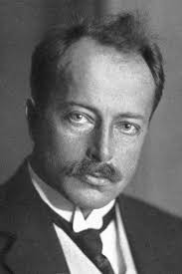
LAUE’S METHOD
Von Laue Won Nobel Prize
The internal structure of crystal could be determined only by Xray diffraction by crystals.
Von Laue studied this and suggested that the crystal could act as a three dimensional diffraction grating for incident Xrays.

Slide 5
Laue’s method
In LAUES METHOD ,continuous beam of Xrays having different wavelengths is made incident on the crystal The X rays get reflecte from various planes of the crystal .Finally these rays reflected from different layers undergo interference to give the diffraction pattern.
Thus the crystal acts as a three dimensional diffraction grating for the beam of incident X rays.
The diffraction pattern recorded on a film shows spots in a symmetric fashion called LAUE’S SPOTS

Slide 6
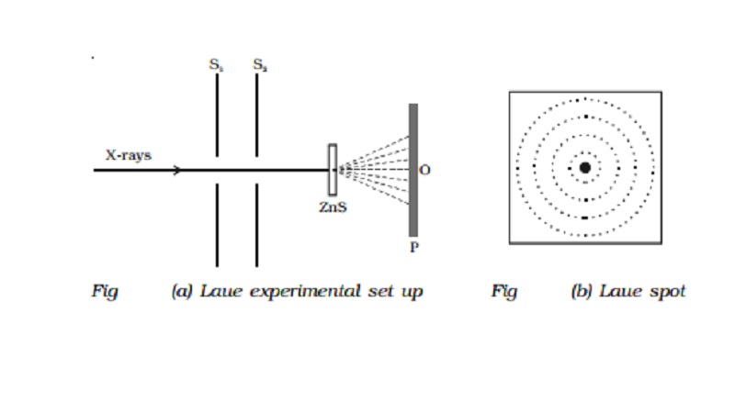
Write short note on Laue’s spots?

Slide 7
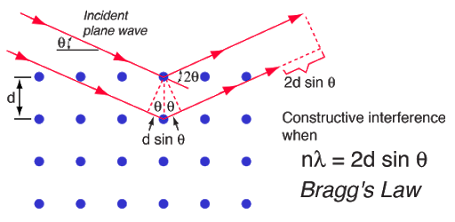
Bragg’s Law
Reference site
http://hyperphysics.phy-astr.gsu.edu/hbase/quantum/bragg.html

Slide 8
Derivation of Bragg’s equation n ƛ =2dSin Ɵ
Bragg proposed that a crystal structure is composed of series of equidistant planes which are also parallel and act as reflection grating for incident rays.
Some of the incident X rays are reflected from plane 1 and some from successive planes.
For constructive interference the rays reflected from successive planes must be in phase and reinforce each other to produce diffraction pattern.
This is possible when the path difference is a whole number multiple of the wavelength.

Slide 9
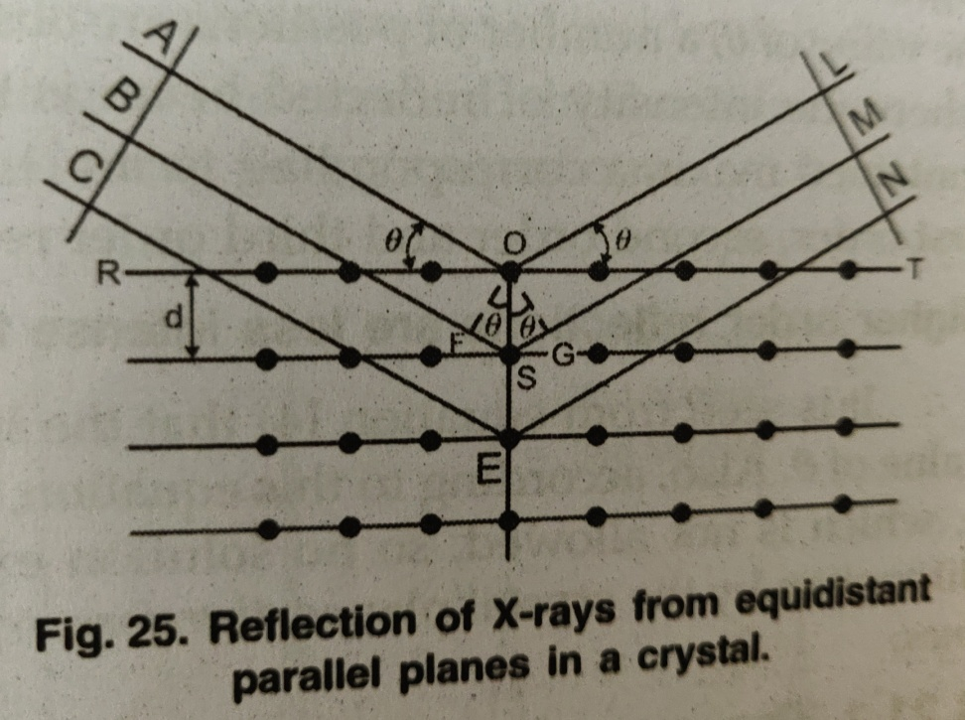
Braggs equation contd…..
The part of rays OL and GM MUST BE IN PHASE and for that the path difference must be whole number multiple of wavelength.
FS+SG=n ƛ ……………………..(1)
WHERE n is an integer.
Angle FOS=Angle AOR=Ɵ
Angle GOS=Angle LOT =Ɵ
Trianle OFS and OSG are congruent
So FS=SG
From equation 1
2FS= n ƛ ………………………………..(2)
Since FS/d =Sin .so FS=dSin
So equation2 can be written as
n ƛ =2dSin Ɵ

Slide 10
Experimental set up of Bragg’s Law
To obtain nearly monochromatic x-rays, an x-ray tube is used to produce characteristic x-rays. In order to eliminate as much of the brehmsstrahlung continuum radiation as possible, matched filters are used in the x-ray beam to optimize the fraction of the energy which is in the K-alpha line. Such filters use elements just above and just below the metal in the x-ray target, making use of the strong "absorption edges" just above and below the K-alpha energy of the target metal.
The x-rays are collimated with apertures in a strong x-ray absorber (usually lead) and the narrow resulting x-ray beam is allowed to strike the crystal to be studied. The spectrometer arrangement couples the rotation of the crystal with the rotation of the detector so that the angle of rotation of the detector is twice that of the crystal. This satisfies the conditions of Bragg's law for diffraction of the x-rays from the crystal lattice planes.

Slide 11
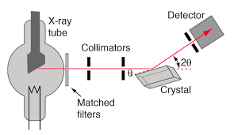
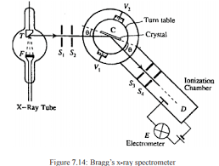
Schematic diagram of Bragg’s Spectrometer
Write short note on these diagrams?

Slide 12
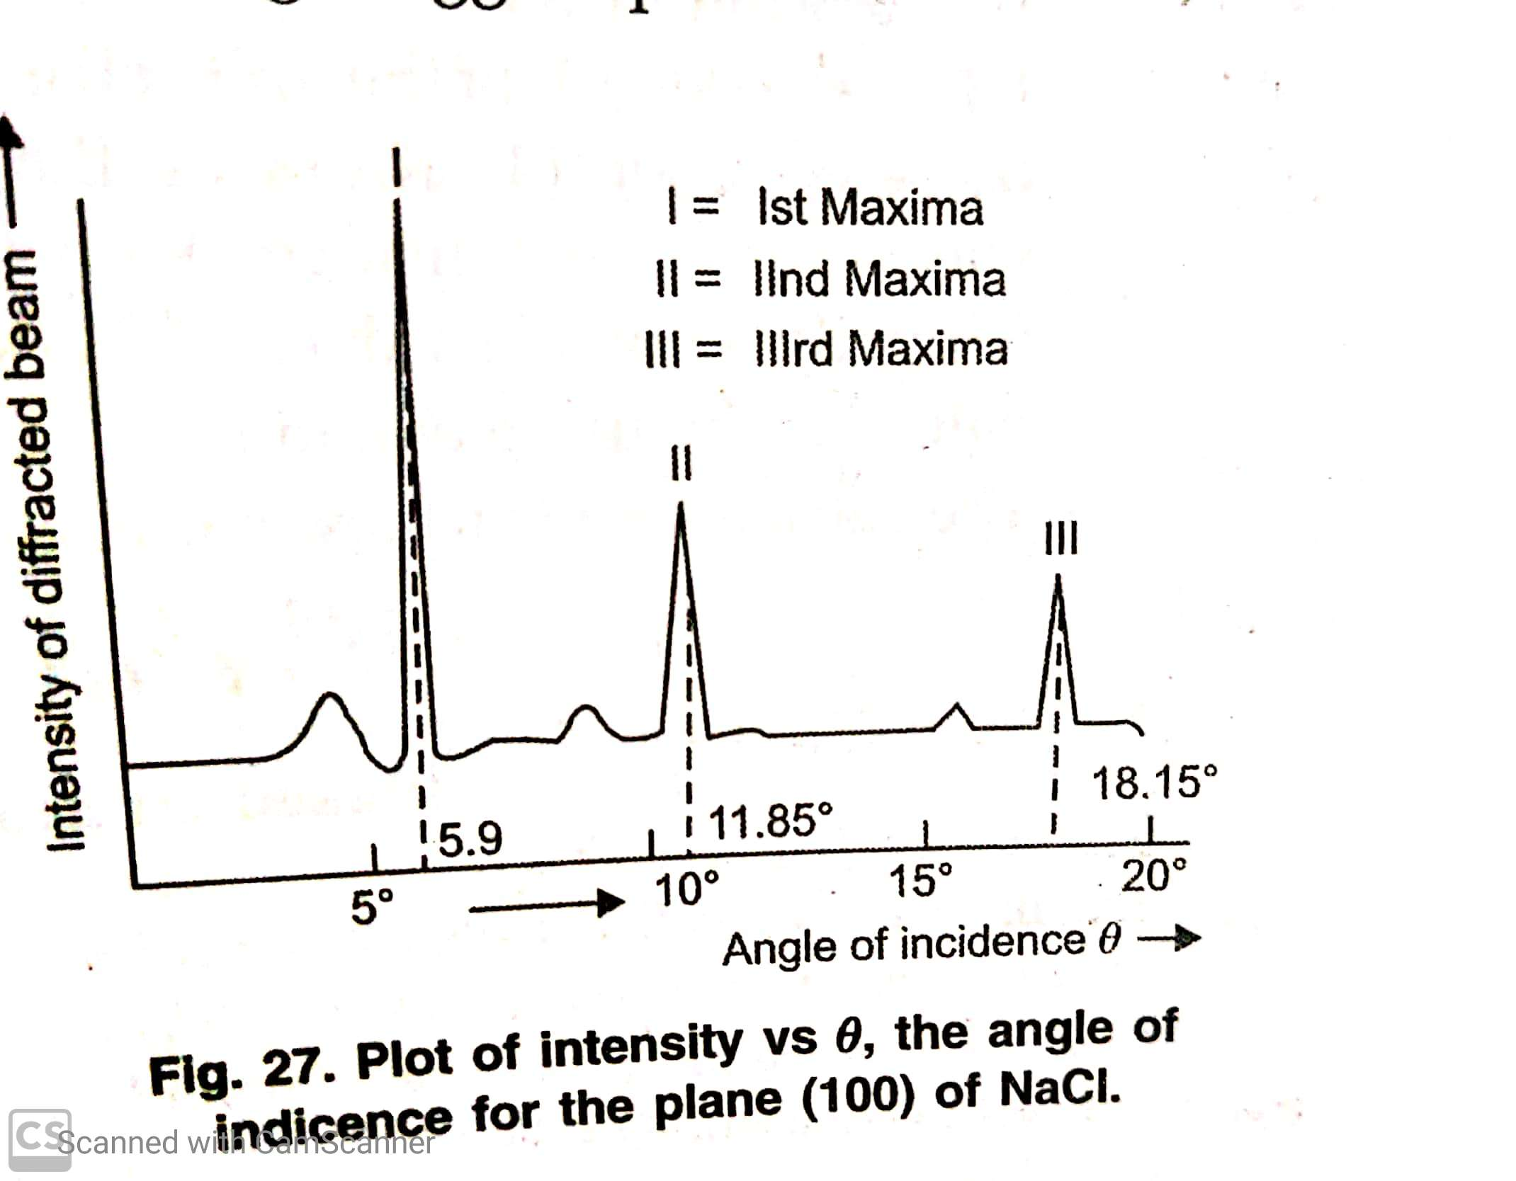
Verification of Bragg’s equation
A plot is drawn between intensity of reflected rays and angle of incidence for [100] Plane of NaCl .
The first ,second and third maxima occur at angles 5.9,11.85,and 18.15 .The sine values for these are 0.013,0.205,0.312 respectively and whole number ratio will be 1:2:3.
Thus proving that first second and third maxima occur for n=1,2,3 respectively
Thus proving that Braggs Equation is correct and valid.

Slide 13

WILLIAM BRAGGS’S SPECTROMETER.
Thanx to William Bragg whose experiment helped us to understand crystal structures.

Slide 14
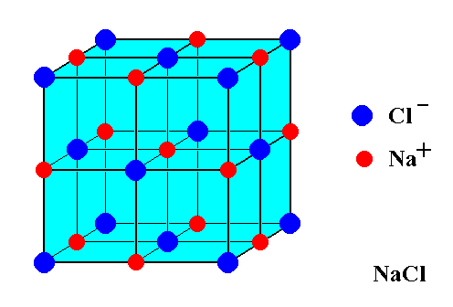
Crystal structure of NaCl
NaCl belongs to fcc crystal .
This was proved by the values of for the first order reflections from first three planes (200),(220),(111).The ratio of three planes is
d₂₀₀:d₂₂₀:d₁₁₁= 1:0.705:1.137 .This ratio confirms fcc.
A unit cell of NaCl contains 4 Na ⁺ ions and 4 Cl⁻ ions.
Cl⁻ ion at corners and face centres [8.1/8 +6.1/2]
Na + ion at edge centres and body centre[12.1/4+1]

Slide 15
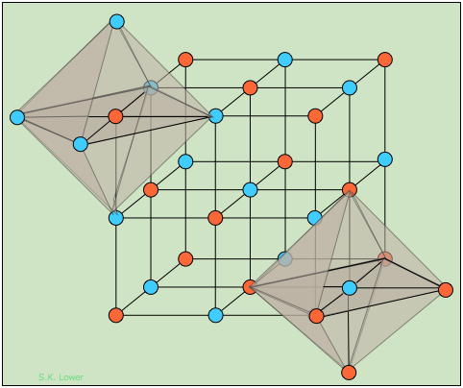
OCTAHEDRON AROUND EACH ION
Each sodium ion surrounded by 6 Cl⁻ ions and each Cl – ion by six sodium ions.
Corners and face centres :chloride ions(orangecolour)
Edge Centre and body centre: sodium ions(blue colour)

Slide 16
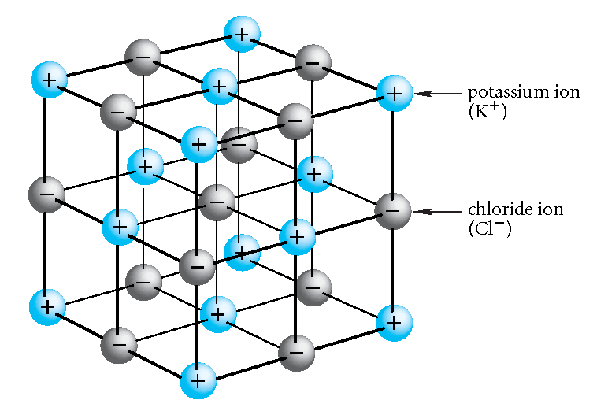
Write short note on structure of KCl?

Slide 17
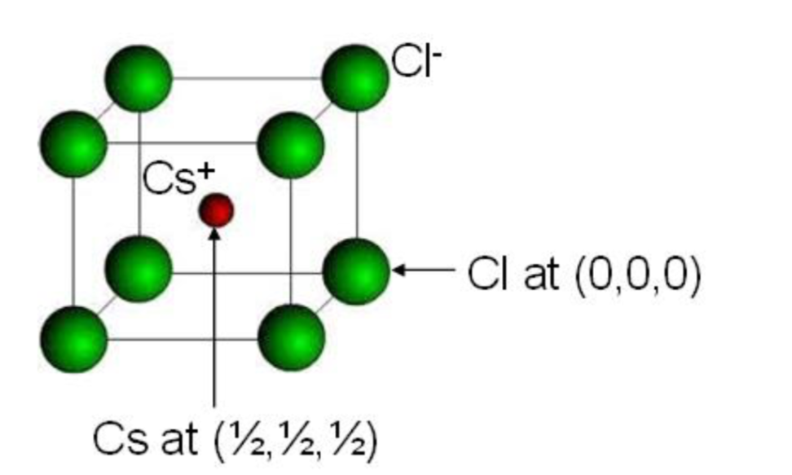
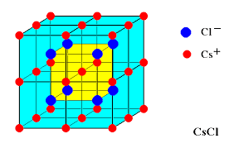
CsCl structure
CsCl has bcc structure.
Chloride ions occupy the corners and caesium ion occupies the body centre.
Unit cell therefore contains one caesium and one chloride ion.
8.1/8 =1(corners)
1 (body centre)

Slide 18
Defects in solids
Any deviation from perfectly ordered arrangement of of ions in a crystal is called imperfection or crystal defect.
It is of two types
Stoichiometric crystal defect
Non stoichiometric crystal defect

Slide 19
STOICHIOMETRIC CRYSTALS AND DEFECTS
The compounds in which the number of positive and negative ions are exactly in the ratios indicated by their chemical formulae are stoichiometric compounds.
The two common defects in these crystals are :Schottky defects and Frenkel defects.

Slide 20
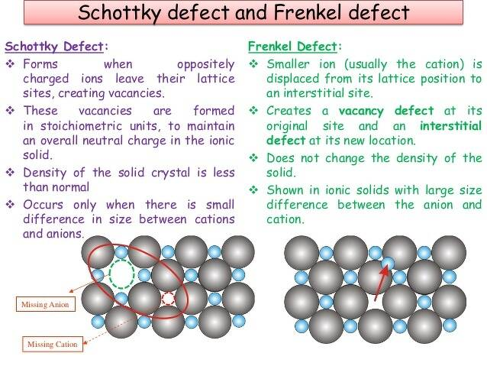
Differences

Slide 21
Conditions causing Schottky and Frenkel defects
Schottky defect
Frenkel defect
High coordination number
Cations and anions of almost similar sizes.
NaCl,CsCl
Low coordination number
Anions are much larger in size than cations.
AgCl,ZnS

Slide 22
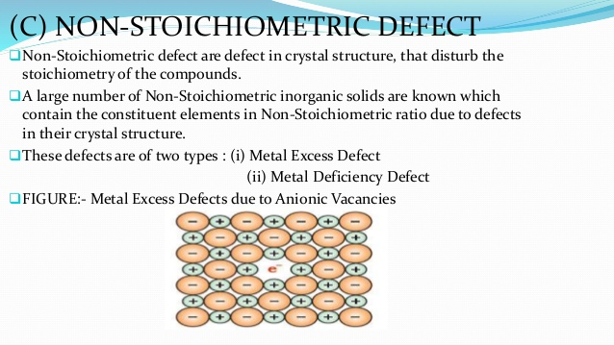
Non stoichiometric defects

Slide 23
Some questions for Practice
Differentiate between metal excess and metal deficient effects?
Represent the following diagramatically:
Bcc lattice
Why NaCl and KCl have different diffraction pattern?
Crystalline solids are anisotropic Comment.
Write short note on isomorphism and polymorphism.

Slide 24
References
http://www.metafysica.nl/turing/preparation_3dim_3.html
http://hyperphysics.phy-astr.gsu.edu/hbase/quantum/bragg.html

